Slide 1
UR Lost & Found
Who We Are
Project Sponsor: Dr. Maciag
Group F: Amr Azouz, Cobie Caburao, Glen Issac, Gabriel Sampaga
Team Leader: Amr Azouz
Notes:
Gabriel

Slide 2
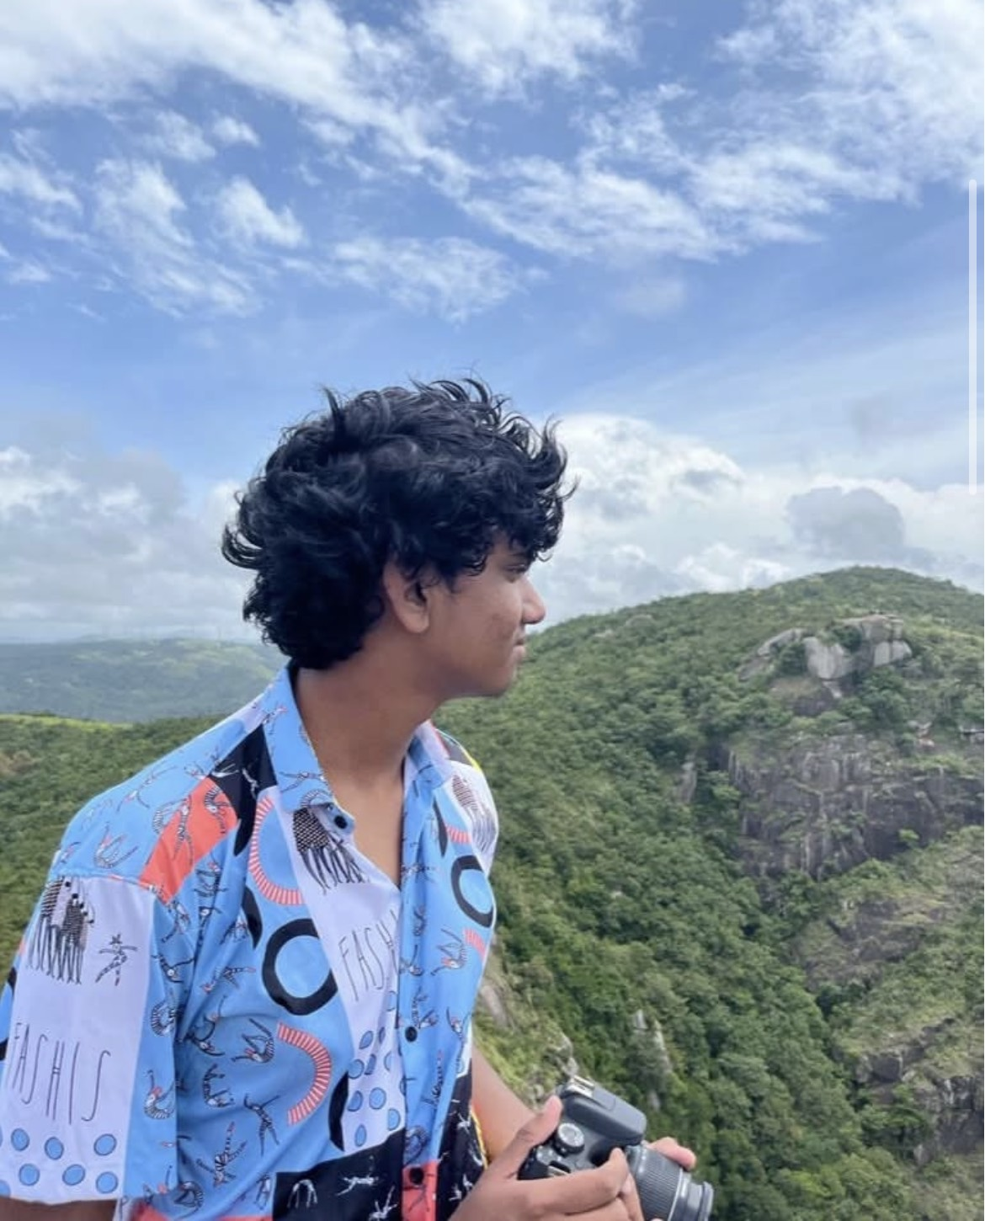
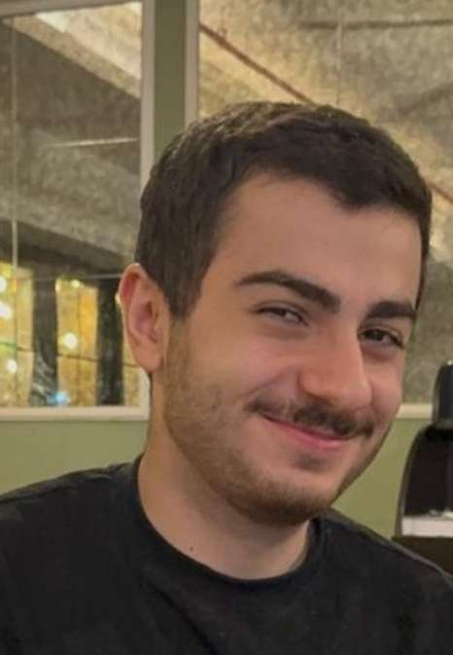
UR Lost & Found
Project Sponsor: Dr. Maciag
Who We Are
Group F: Amr Azouz, Cobie Caburao, Glen Issac, Gabriel Sampaga
Team Leader: Amr Azouz
Notes:
Gabriel

Slide 3
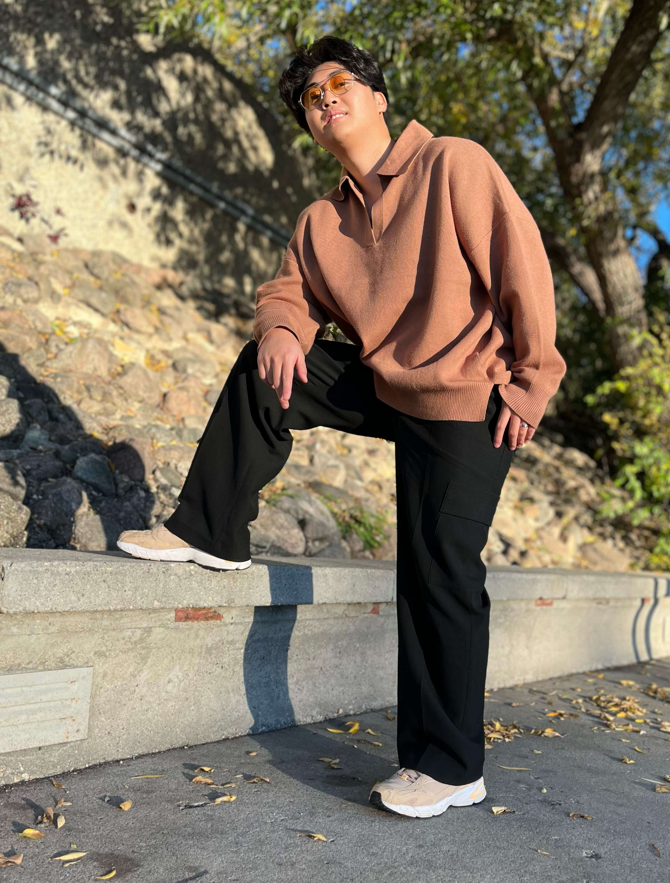
Who We Are
Team Leader: Amr Azouz
Cobie Caburao
Notes:
Gabriel

Slide 4
Who We Are
Team Leader: Amr Azouz
Cobie Caburao
Glen Issac
Notes:
Gabriel

Slide 5
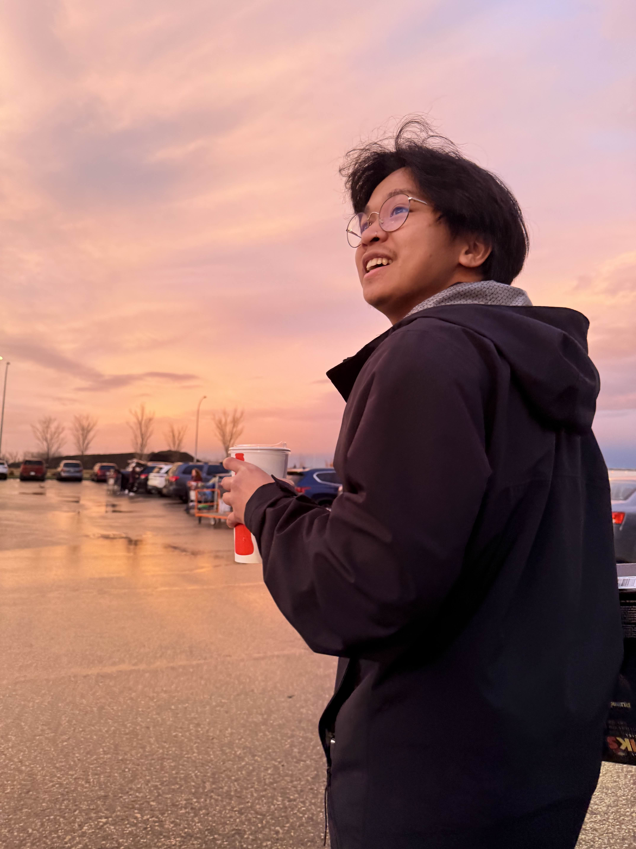
Who We Are
Team Leader: Amr Azouz
Cobie Caburao
Glen Issac
Gabriel Sampaga
Notes:
Gabriel

Slide 6
Group F
Who We Are
Glen Issac
Team Leader: Amr Azouz
Gabriel Sampaga
Cobie Caburao
Notes:
Gabriel

Slide 7
Group F
Let me paint you a picture
Team Leader: Amr Azouz
Gabriel Sampaga
Glen Issac
Cobie Caburao
Notes:
Gabriel

Slide 8
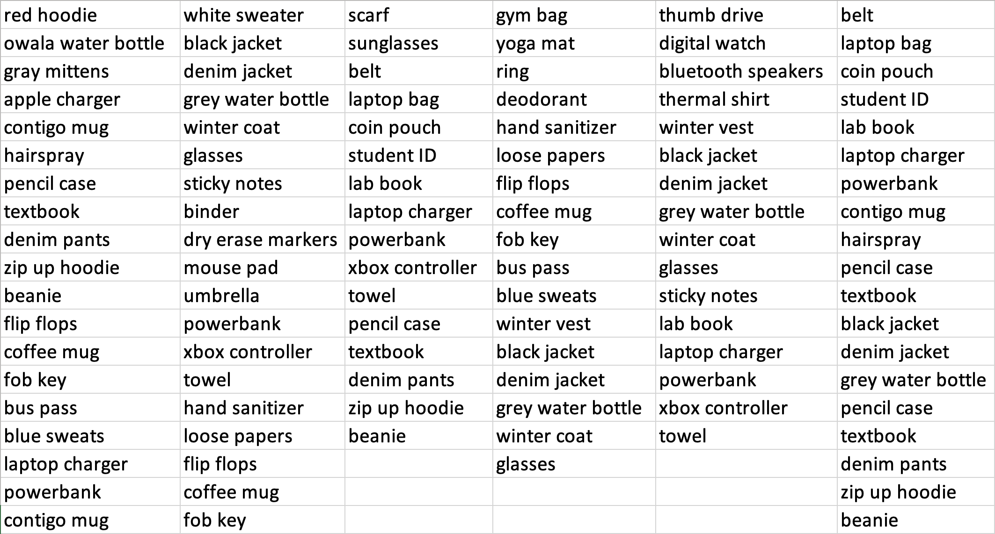
Group F
Let us paint you a picture
Team Leader: Amr Azouz
Gabriel Sampaga
Glen Issac
Cobie Caburao
Notes:
Gabriel

Slide 9
Let me paint you a picture
Notes:
Gabriel

Slide 10
That’s the current UR Lost & Found
Notes:
Gabriel

Slide 11
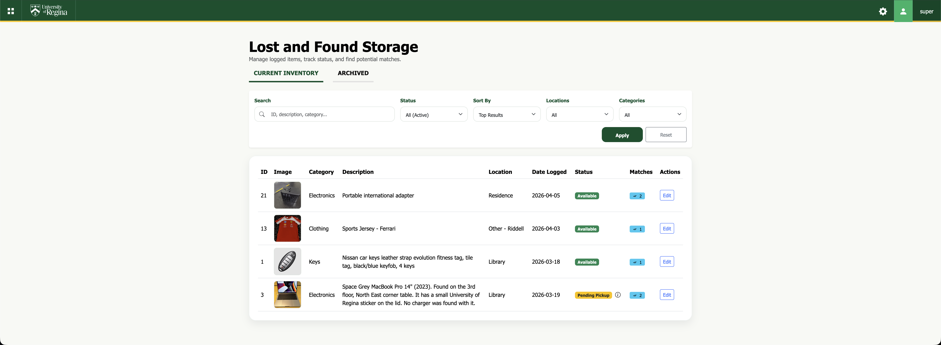
Can you find it again: Group F’s
UR Lost & Found
Notes:
Gabriel

Slide 12
Golden Circle
Can you find it again: Group F’s
UR Lost & Found
Notes:
Gabriel

Slide 13
Golden Circle
Thank you, Tim!
Why
Notes:
Amr

Slide 14
Golden Circle
Why
How
Notes:
Amr

Slide 15
Golden Circle
How
What
Why
Notes:
Amr

Slide 16
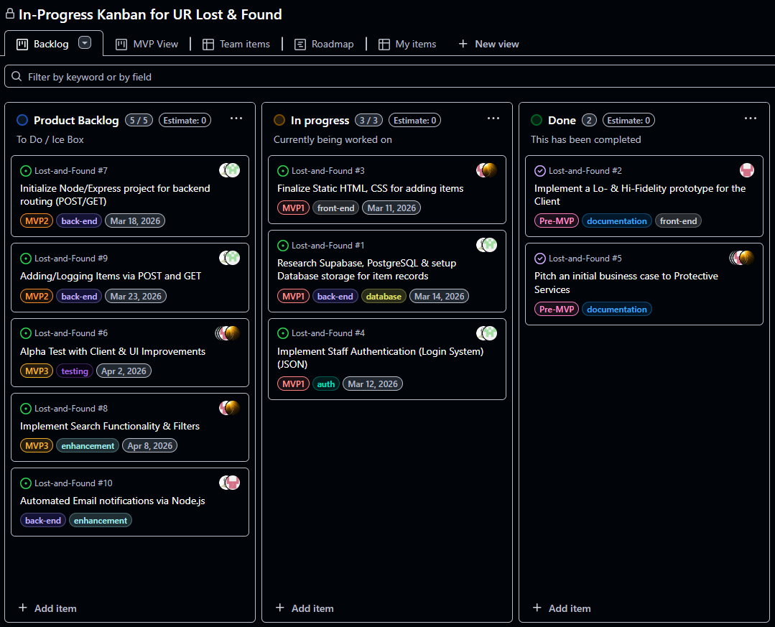
Who
Golden Circle
Initial Kanban Board
What
How
Why
Notes:
Amr

Slide 17
Golden Circle
Initial Kanban Board
Who
What
How
Why
Notes:
Amr

Slide 18
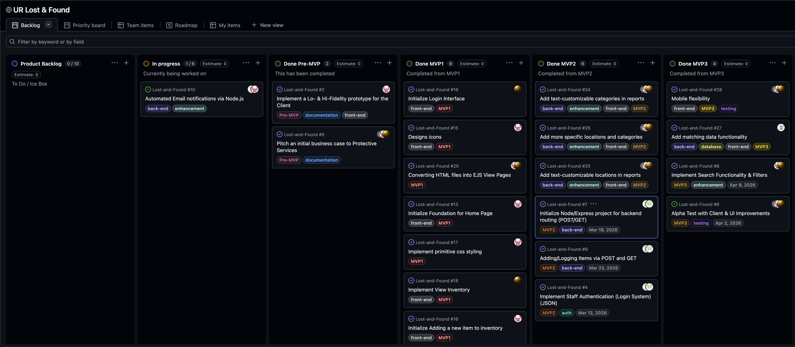
What
How
Golden Circle
Why
Initial Kanban Board
Updated Kanban Board
Notes:
Glen

Slide 19
Updated Kanban Board
Notes:
Glen

Slide 20
Updated Kanban Board
Notes:
Glen

Slide 21
Updated Kanban Board
Notes:
Glen

Slide 22
Updated Kanban Board
Notes:
Glen

Slide 23
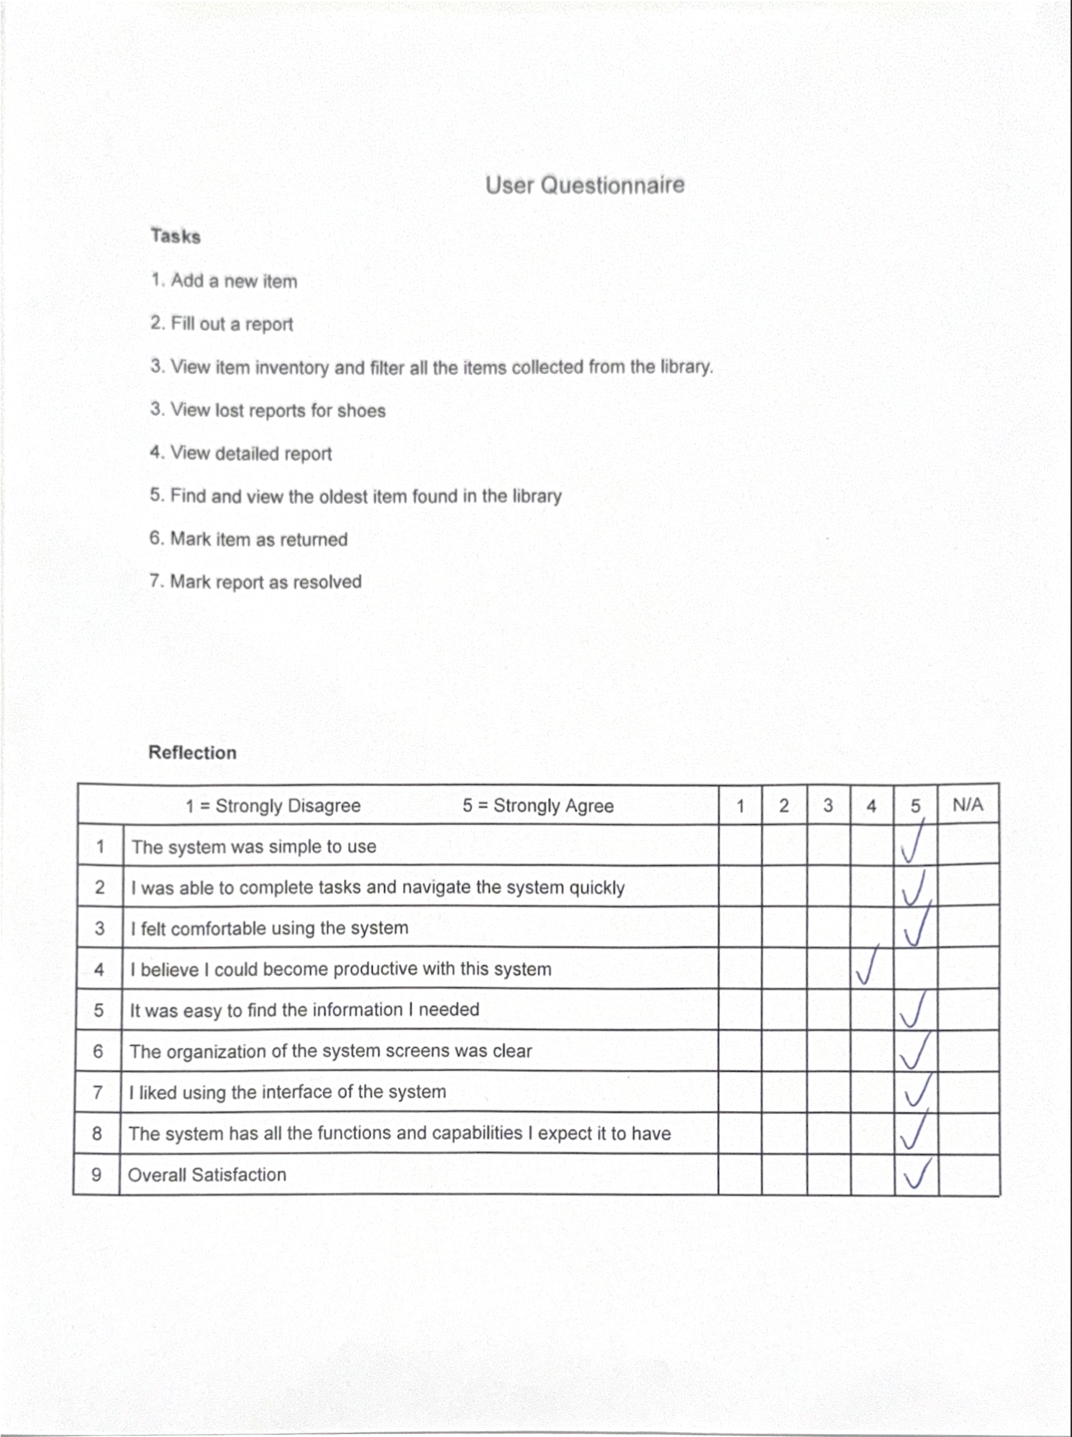
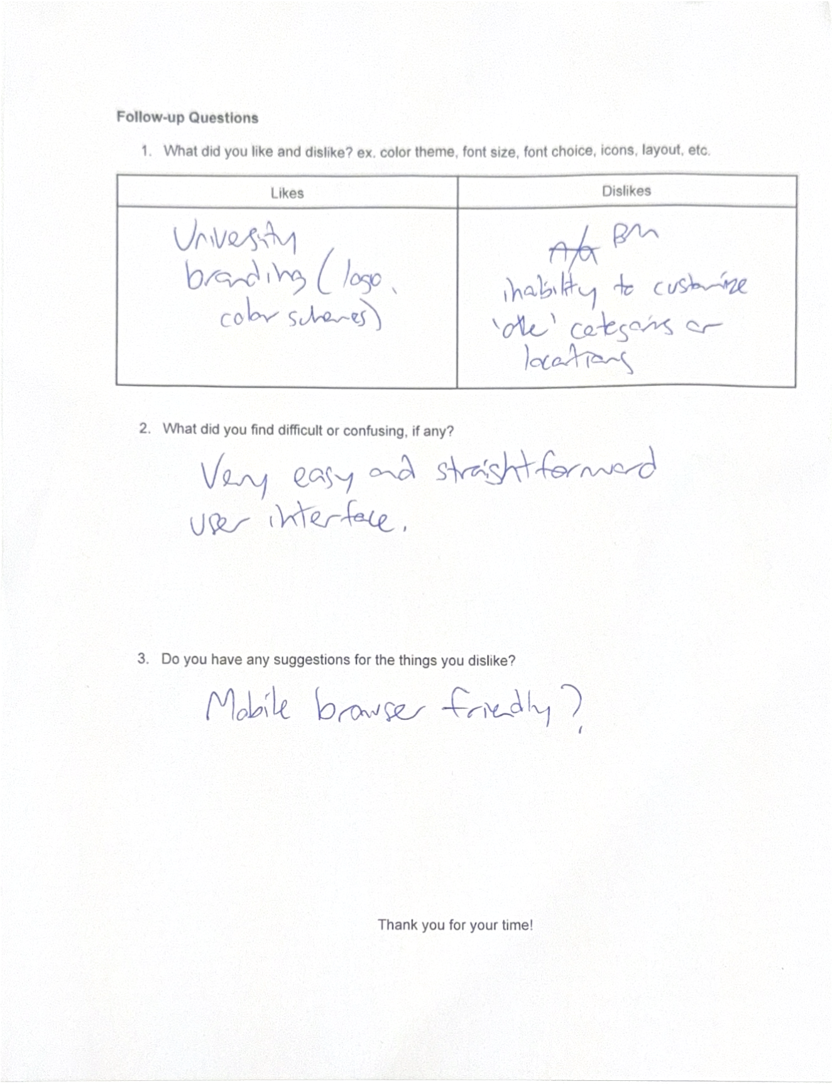
Brad’s Contributions
Updated Kanban Board
Notes:
Glen

Slide 24
Updated Kanban Board
Brad’s Contributions
Notes:
Cobie

Slide 25
Brad’s Contributions
Notes:
Cobie

Slide 26
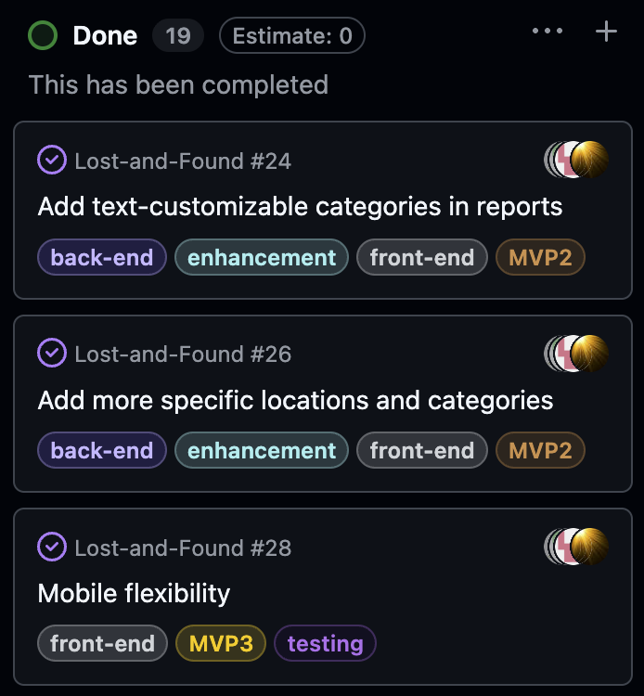
Brad’s Contributions
Notes:
Cobie

Slide 27
Brad’s Contributions
Notes:
Cobie

Slide 28
Amr’s Mobile Demo
Brad’s Contributions
Notes:
Cobie

Slide 29
Why are they MVPs?
Brad’s Contributions
Amr’s Mobile Demo
Notes:
Cobie

Slide 30
Why are they MVPs?
Amr’s Mobile Demo

Slide 31
A working product

Slide 32
Thank you!

